Slide 1
Work allocation Automation Portal for an Institute
Done By :-
Prateek Karn (20BCE1771)
Deepavarshini (20BCE1661)
Gautham Rajan T S (20BCE1484)
Kaushik K (20BCE1416)

Slide 2
Abstract
Create and deliver a working portal to automate work allocation process in which two/three courses will be allocated to each faculty based on their preferences and Courses required based on Students’ Wishlist.

Slide 3
Project Link
GitHub Link :

Slide 4
Tools and Concepts used in Project
HTML, CSS and JavaScript
SQL for query processing
Django for entire web-framework

Slide 5
HTML, CSS and JavaScript
The front-end of the project is developed using HTML(body structure) and CSS(for designing).
Javascript is used mainly during the retrieval of data when the excel file is uploaded.
Various static pages have been created and are merged.

Slide 6
SQL
With the help of SQL queries, the data from the dataset is retrieved according to the condition.
SQL helped in creating the tables, retrieving the values and performing specific operations on the data.

Slide 7
Features of Admin Page
Upload Courses
View and add Courses
Wishlist data
Faculty Info
View faculty preferences
Allocation

Slide 8
Features of Faculty Page
Course Preferences
Allocated Courses

Slide 9
Upload Courses
Needs to have an upload thingy like there is in moodle where we upload assignments (this is an input element in html)
Once uploaded it has to be given to backend and parsed into the sql database - SQL

Slide 10
View and Add Courses
SQL query/report to show all courses in the database
Allow admin to add records (generate an insert request) - SQL

Slide 11
Wishlist Data
Display student wishlist (excel sheet) data
Query must have condition to not show any course with count less than 10
Batch capacity is 70, calculate number of batches required - SQL

Slide 12
Faculty Info
Similar to students wishlist
Input an excel file and parse it into the database as a table - SQL
Add a request to generate an Insert as the admin - SQL

Slide 13
View Faculty preferences
List out the faculty name, email, status (of submitting preferences; values like “filled in” or “pending” ) - SQL
Provide a button to auto generate an email to remind pending faculty to submit their preferences

Slide 14
Allocation
Have a button to calculate allocation of teachers
Allocate 2 course to each faculty
Sort it by designation (probably type enum with “Professor” (highest value), “Associate Professor”, “Assistant Professor”
Count no of preferences from profs and make a table that has courses, No. of batches and no of batches after allocation to profs
Make it so Only profs can login day 1, associates on day 2, assistants day 3, show them each a different table that shows after associates and after profs, only show courses that need them
Make sure that there aren’t copies of same course in lower prefs

Slide 15
This should be made illegal
You can allocate the same course to a faculty twice (like pref 1 is cse 1001 then give 2 or 3 batches of CSE1001 (3rd one should be round robin imo)
Remove courses shown if all the batches are taken away by higher prio faculty
Add button to view courses
Add button to edit faculty courses (I say to the right of the records in the table)
Add approve button next to faculty (right of the edit button)
Add a approve all at the bottom
Download button, make a report and make a request to print

Slide 16

Screenshots

Slide 17
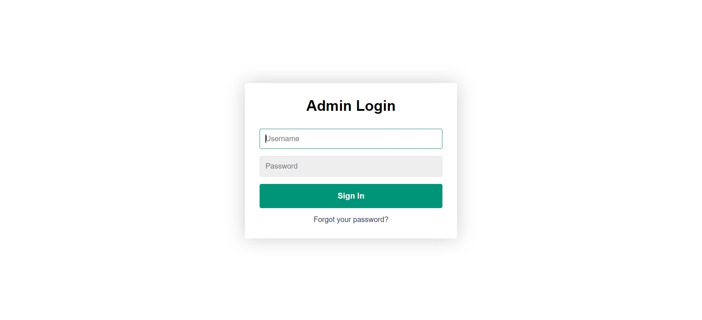

Slide 18
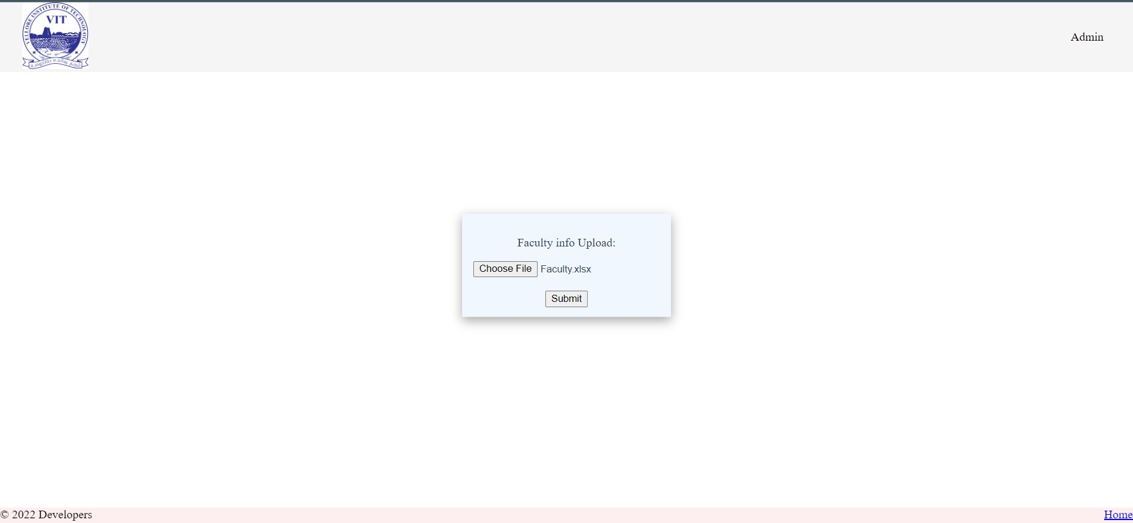

Slide 19
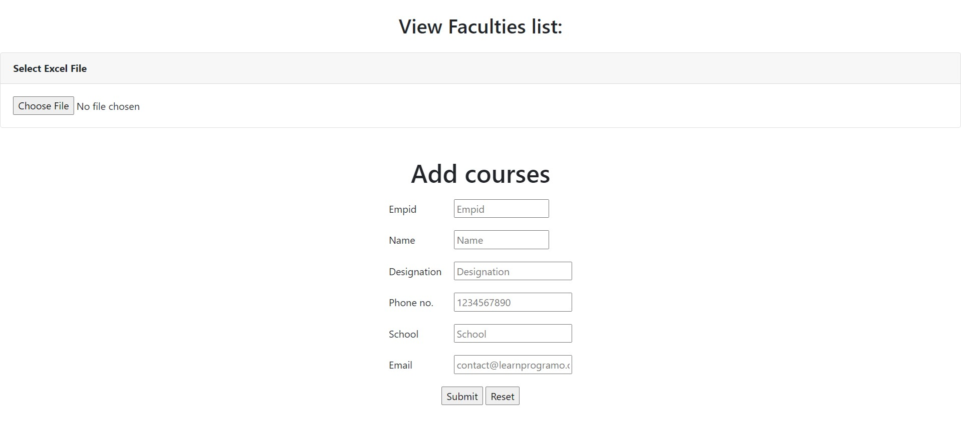

Slide 20
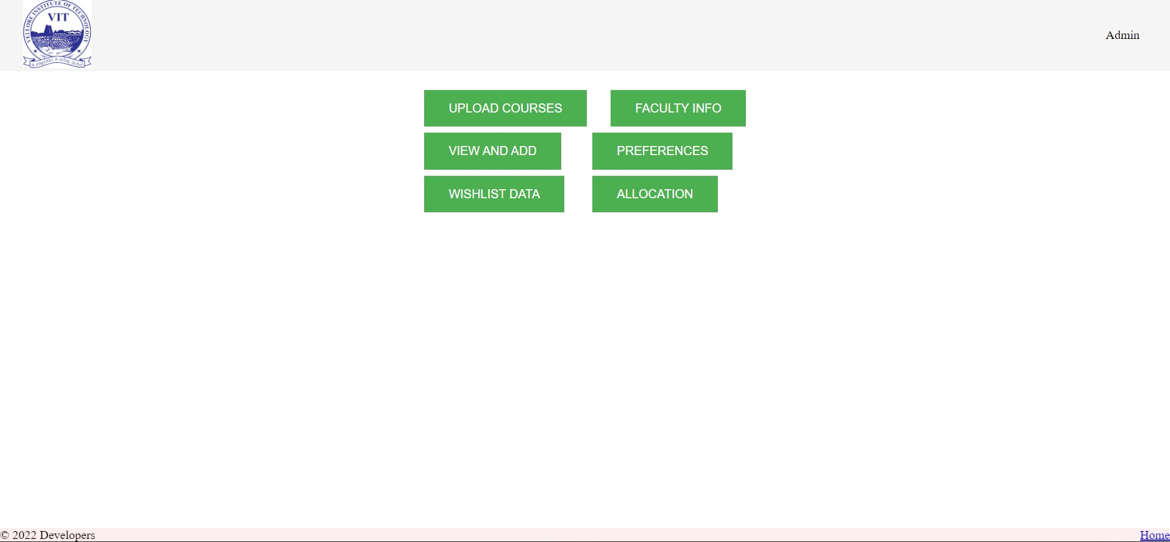

Slide 21
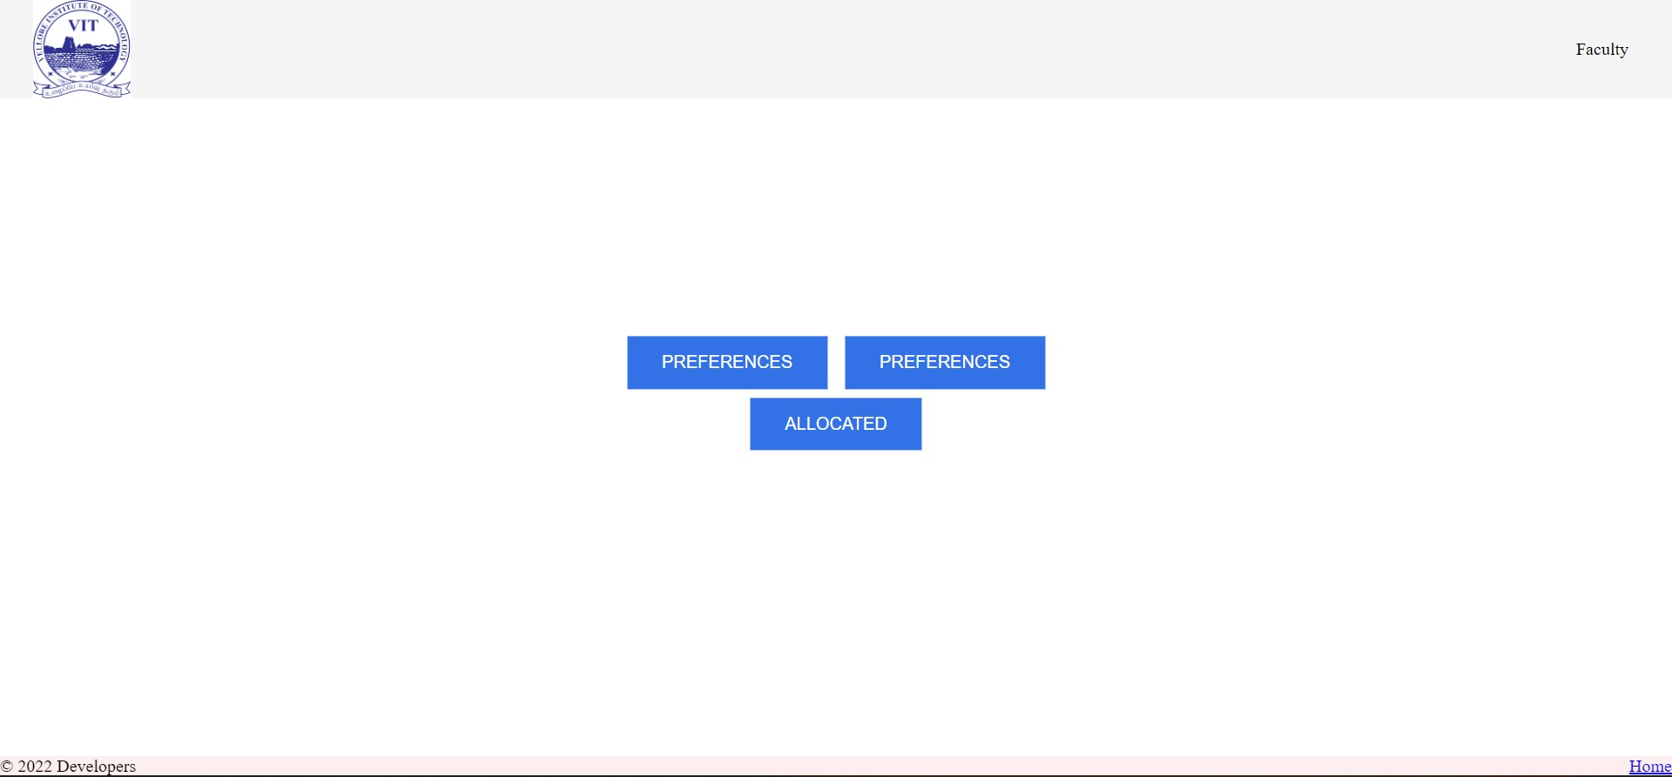

Slide 22
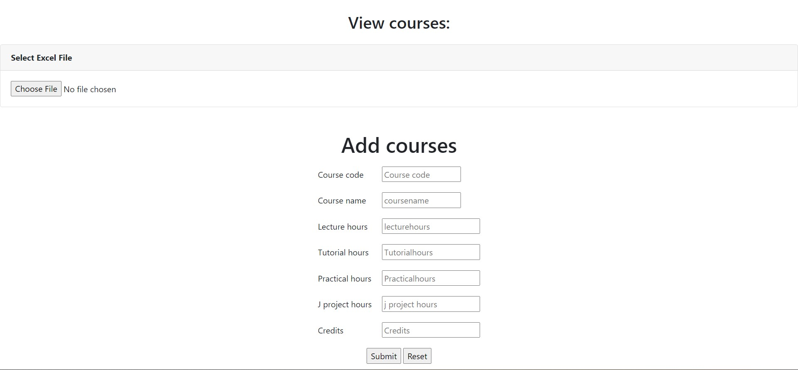

Slide 23
